Slide 1
REVPLAY
- Seamless audio, dynamic user experience, and secure music management.
- under guidance by : Remya G
Team Members & Roles:
O. Hemanth Sateesh kumar : Team Lead & User & Auth Service
D. Devi Prasad: Catalog Service
G. Saikiran: Artist Analytics Service
K. Rekha: Playlist & Favorites
D. Ahmad Ali: Playback Service

Slide 2
Project overview
RevPlay : A full-stack music streaming web application that allows users to listen to music, manage playlists, and enables artists to upload and manage their own tracks.
The Goal : To build a platform that doesn't just play music, but provides a persistent, modern, "no-refresh" experience.
Key Features :
Role-based access (Listeners vs. Artists).
Persistent, global audio player.
Real-time UI updates without page refreshes.
Custom playlist and favorites management.

Slide 3
Our Technology Stack
Frontend (The User Interface) :
Angular : Component-based UI.
RxJS : For reactive state management (managing the global audio state).
HTML5/CSS3 : For a responsive, modern dark-mode aesthetic.

Slide 4
Our technology stack
Backend (The Brain & Security):
Spring Boot 3.4 : Core backend framework.
Springdoc OpenAPI (Swagger) : For dynamic API documentation.
Spring Security & JWT : For stateless, secure authentication.
Database :
MySQL & Spring Data JPA : For relational data mapping.

Slide 5
Our technology stack
JUnit : Utilizing JUnit to automatically test individual pieces of backend logic.
Guaranteeing that when we add a brand new feature, our existing code remains unbroken and fully functional.

Slide 6
Database Architecture(ER Diagram)
Robust relational structure handling Users, Songs, Albums, Playlists, and History.
Many-to-Many relationships for Playlists and Favorites.
Foreign key constraints to ensure data integrity (e.g., deleting a song cascades appropriately).

Slide 7
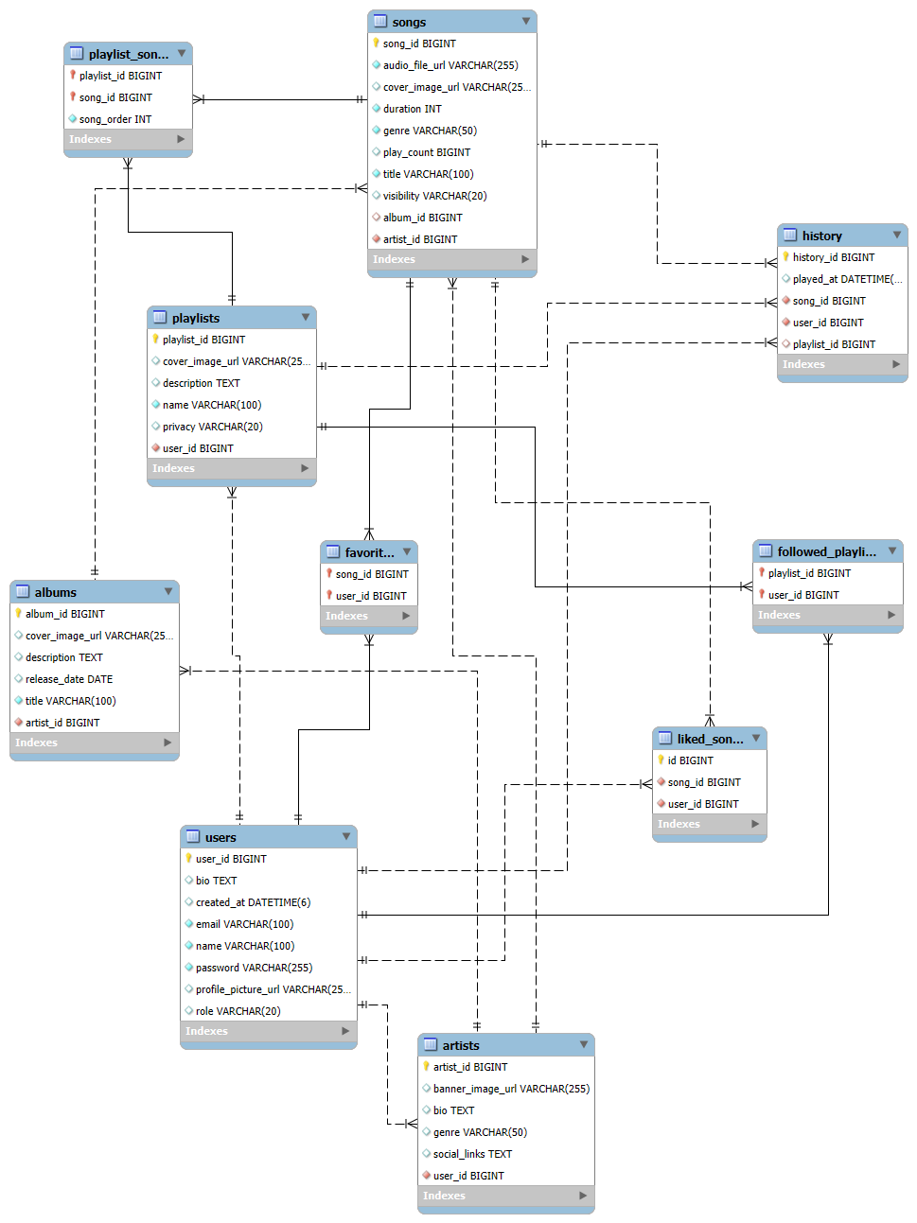

Slide 8
Architecture
Core Infrastructure Modules:
revplay-eureka-server: Service discovery allowing microservices to locate each other dynamically.
revplay-config-server: Centralized configuration server managing properties across all environments for every service.
revplay-api-gateway: Routes incoming frontend requests to the appropriate backend service and handles rate-limiting.
Routing:
Angular routing remains independent from the global audio player state to guarantee uninterrupted playback

Slide 9
Individual Contribution – Hemanth (Lead)
Name & Role: Hemanth – User & Auth Service
Target Audience: All Users (Listeners & Artists)
Backend Flow: Built revplay-user-service for profile management and revplay-auth-service for stateless JWT token generation. Configured the revplay-api-gateway.
Frontend UI (Angular):
Implemented secure registration and login flows.
Engineered token handling via HTTP interceptors.
Set up strict Route Guards enforcing Role-Based Access Control (RBAC)—ensuring Listeners cannot access Artist-only pages.

Slide 10
Individual Contribution – Devi Prasad
Name & Role: Devi Prasad – Catalog Service
Target Audience: Listeners (Discovery) & Artists (Uploads)
Target Audience: Listeners (Discovery) & Artists (Uploads) Backend Flow: Developed revplay-catalog-service to manage the core library database (Songs and Artists).
Frontend UI (Angular): For Listeners: Built dynamic song listing pages, global search, real-time catalog filtering by genre, and integrated a persistent global audio player with play, pause, skip, and mute controls. For Artists: Implemented the secure multipart file upload UI, allowing creators to submit .mp3 files and cover art directly to the catalog.

Slide 11
Individual Contribution – Saikiran
Name & Role: Saikiran – Artist Analytics Service
Target Audience: Strictly Artists (Content Creators)
Backend Flow: Engineered revplay-analytics-service to asynchronously process streaming events and generate performance metrics.
Frontend UI (Angular):
Built the exclusive "Creator Dashboards" restricted to the Artist role.
Designed complex data visualizations.
Displayed real-time metrics including play counts, popularity trends, and top listener engagement.

Slide 12
Individual Contribution – Rekha
Name & Role: Rekha – Playlist & Favorites
Target Audience: All Users (Personalization for Listeners & Artists)
Backend Flow: Created revplay-playlist-service and revplay-favorite-service to manage Many-to-Many relational user data independently.
Frontend UI (Angular):
Playlists: Built interfaces to create and edit playlists, complete with Public/Private visibility toggles.
Favorites: Implemented instant, reactive one-click add/remove functionality for favorites.
Designed the personalized user library and discovery screens

Slide 13
Individual Contribution – Ahmad
Name & Role: Ahmad – Playback Service Target Audience: All Users (The Core Audio Experience)
Backend Flow: Built revplay-playback-service to album management, (create albums, add/remove songs, delete albums) and integrate with Catalog Service using Feign Client. Implemented listening history tracking, recently played display, total listening time, and analytics like top listeners and listening trends.
Frontend UI (Angular): Displayed Recently Played songs dynamically using listening history APIs for a personalized playback experience.

Slide 14
Shared / Collaborative Work
Common Services: Standardized Angular HTTP Interceptors to automatically attach JWTs to API requests, and built Role Guards (isListener, isArtist) used across the team.
Routing Config & Environments: Mapped environment variables in Angular directly to the revplay-api-gateway URL, relying on the backend revplay-eureka-server and revplay-config-server to handle the dynamic routing behind the scenes.
Testing Approach: Maintained comprehensive unit tests (*.spec.ts) for critical services, particularly the reactive global audio state.

Slide 15
Current achievements
Present (What We Have Built) :
A robust, cloud-native web application providing independent features tailored securely for both Listeners and Artists.
Fully Functional Streaming Engine: A persistent, global audio player built with Angular and RxJS that allows uninterrupted listening.
Secure Creator Ecosystem: Artists can securely upload .mp3 files and cover art via multipart Spring Boot APIs.
Interactive User Library: Listeners can seamlessly manage custom Playlists, Favorites, and automated Listening History.
Role-Based Security: Strict JWT authentication ensuring data privacy and correct access levels.

Slide 16
Future scope
AI-Powered Recommendations: Implementing machine learning algorithms to analyze a user's listening history and auto-generate personalized "Discover Weekly" playlists.
Premium Subscriptions & Payments: Integrating a payment gateway (like Stripe) to offer ad-free listening tiers and allow fans to financially support their favorite artist.
Collaborative Playlists: Building real-time WebSocket connections so multiple friends can add, reorder, and listen to tracks in a shared playlist simultaneously.

Slide 17
Conclusion
Delivered a premium, modern streaming environment where the music never stops while users explore the app.
Successfully bridged the gap between listeners discovering new tracks and artists managing their portfolios.
Empowered users to curate their own music experience through custom playlists, instant favorites, and automated history tracking.
Collaborated to design, build, and secure a complete, real-world application from the ground up.

Slide 18
THANK YOU

